Slide 1
Banking BoT using Machine Learning Techniques
Submitted in the partial fulfillment for the award of the degree of
BACHELOR OF ENGINEERING
IN
COMPUTER SCIENCE(DevOps)
Submitted by:
21CDO1034 Deepanshi Tomar 21CDO1039 Mummareddy Devaharsha 21CDO1045 Dikshesh Kumar 21CDO1052 Ashutosh Jena 21CDO1056 Aneesh
Under the Supervision of:
Dr. Preet Kamal
Department of AIT-CSE
DISCOVER . LEARN . EMPOWER

Slide 2
Outline
Introduction to Project
Problem Formulation
Objectives of the work
Methodology used
Results and Outputs
Conclusion
Future Scope

Slide 3

Introduction to Project
Introducing our innovative Banking Bot, powered by machine learning. This intelligent assistant provides 24/7 support, helping you manage your finances with ease. Our Bot understands your questions about accounts, transactions, and services, and can facilitate secure payments and transfers. Additionally, it leverages machine learning to deliver personalized financial insights, all within a user-friendly and secure platform.

Slide 4

Problem Formulation
Problem: Limited access to banking services due to inconvenient hours and long wait times creates a need for a more efficient and personalized customer experience.
Solution: Develop a secure and intelligent Banking Bot leveraging Machine Learning and Natural Language Processing (NLP) to:
Understand user queries and intent.
Provide real-time access to account information and complete transactions.
Offer personalized financial recommendations and support.

Slide 5
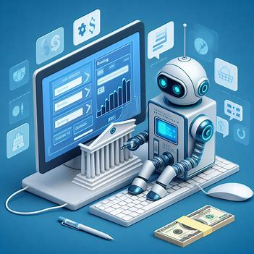
Objectives of the Work
Leverage machine learning to automate and streamline core banking tasks, enhancing operational efficiency and accuracy.
Deliver a superior customer experience by utilizing machine learning for personalized recommendations and proactive fraud detection.
Optimize risk management through machine learning-powered prediction of loan defaults and creditworthiness, ensuring financial stability.

Slide 6
Methodology used
NLP (Natural Language Processing):
Natural Language Processing (NLP) plays a crucial role in Machine Learning (ML) applications, particularly those that involve human language interaction. Here's how NLP empowers banking chatbots:
NLP techniques allow chatbots to process and understand natural language user queries.
This goes beyond simply recognizing keywords; NLP can break down sentences, identify grammatical structures, and extract meaning from the user's intent.

Slide 7
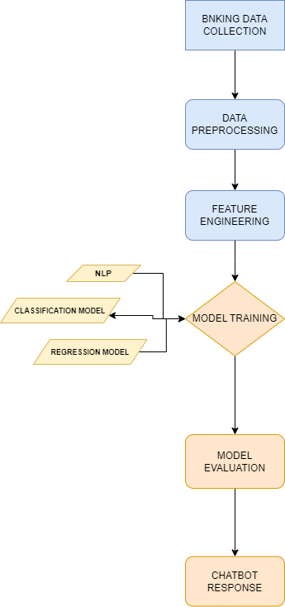
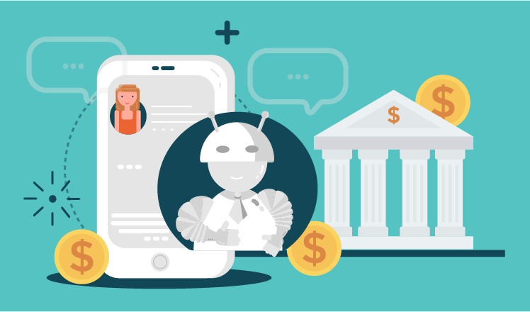

Slide 8
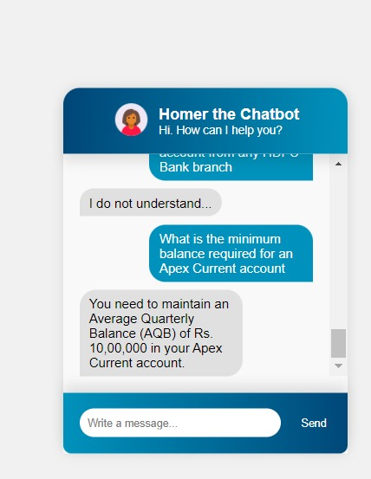
Results and Outputs
Results: The Banking BoT leverages machine learning to understand user queries and provide real-time support. By analyzing past interactions, the BoT refines its responses over time, offering a constantly improving customer experience.
Outputs:
Personalized Interactions: By analyzing user data, the chatbot can offer targeted recommendations and financial insights, enhancing the customer experience.
Seamless Escalation: For complex inquiries, the chatbot can intelligently route users to live agents, ensuring efficient issue resolution.

Slide 9

Conclusion
This partnership between machine learning and NLP has successfully achieved its objective: to create a smoother, more personalized, and ultimately more delightful banking experience for everyone.
It's a win-win for both customers and banks, paving the way for a future where banking feels less like a chore and more like a seamless extension of your financial life.

Slide 10
Future Scope
Predictive Analytics: Banking bots can leverage machine learning to analyze user data and financial habits. This enables them to proactively offer personalized financial advice, suggesting budgeting strategies, investment opportunities.
Goal Setting and Tracking: Chatbots can become financial coaches, helping users set financial goals (saving for a house, paying off debt) and track progress over time.

Slide 11
THANK YOU

